Slide 1
DATA SCIENCE
WELCOME FUTURE DATA SCIENTISTS

Slide 2
Why data science ?
The field of data science is evolving into one of the fastest-growing and most in-demand fields in the world. Organizations across industries are looking to make sense of the data they can now collect from new technologies – from predicting the next hot product to determining the risk of an infectious disease outbreak.
Exciting new effective applications of data analytics
e.g., Google Flu Trends:

Slide 3
What is it ?
Data science is a multidisciplinary blend of data inference, algorithmm development, and technology in order to solve analytically complex problems.
At the core is data. Troves of raw information, streaming in and stored in enterprise data warehouses. Much to learn by mining it. Advanced capabilities we can build with it. Data science is ultimately about using this data in creative ways to generate business value
Data Science is the science which uses computer science, statistics and machine learning, visualization and human-computer interactions to collect, clean, integrate, analyze, visualize, interact with data to create data products.

Slide 4
V’s of BIG DATA
Volume
Velocity
Variety
Variability
Veracity
Visualization
Value.

Slide 5
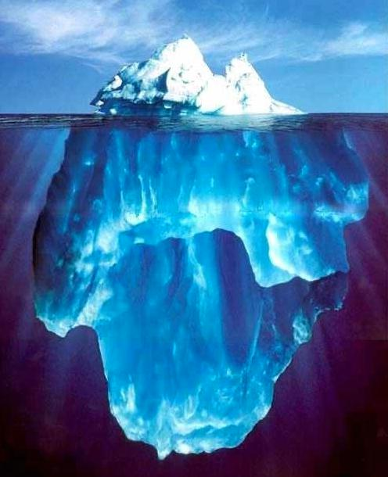





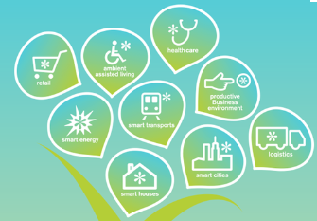
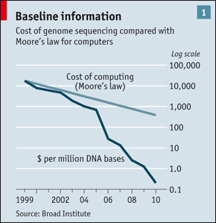
Where do we get data from ?
User Generated (Web & Mobile)
Every:
Click
Ad impression
Billing event
Fast Forward, pause,…
Server request
Transaction
Network message
Fault
…
…..
Internet of Things / M2M
Health/Scientific Computing

Slide 6
Aim of data science
This aspect of data science is all about uncovering findings from data. Diving in at a granular level to mine and understand complex behaviors, trends, and inferences. It's about surfacing hidden insight that can help enable companies to make smarter business decisions. For example:
Netflix data mines movie viewing patterns to understand what drives user interest, and uses that to make decisions on which Netflix original series to produce.
Target identifies what are major customer segments within it's base and the unique shopping behaviors within those segments, which helps to guide messaging to different market audiences.
Proctor & Gamble utilizes time series models to more clearly understand future demand, which help plan for production levels more optimally.

Slide 7
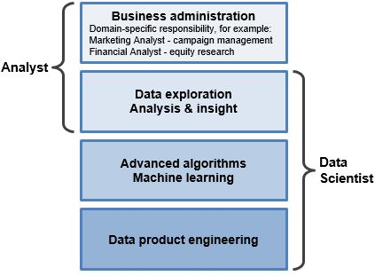
What makes you different?
What makes you different?

Slide 8
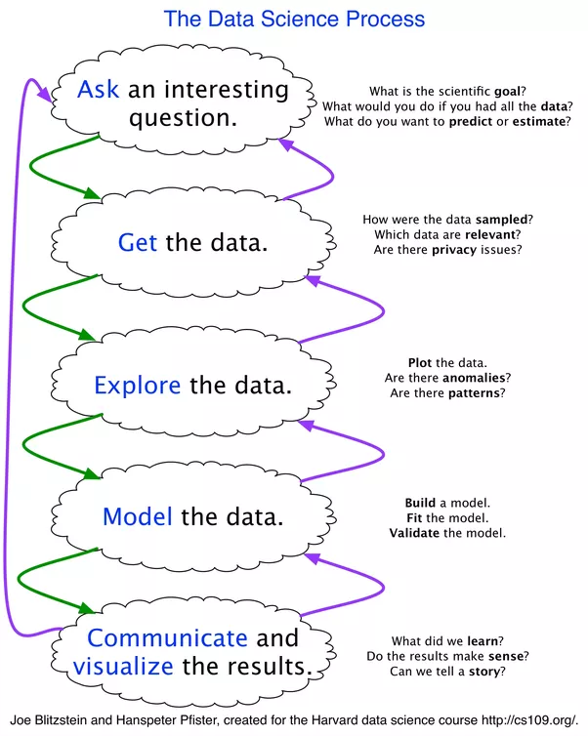

Slide 9
Data science technologies
Python(best language for data science)
Anaconda
R
Sklearn
Mongo DB
Spark(ML,Streaming,etc..)
HDFS
Tableau

